Slide 1

Annona Elizabeth alias anz data science

Slide 2
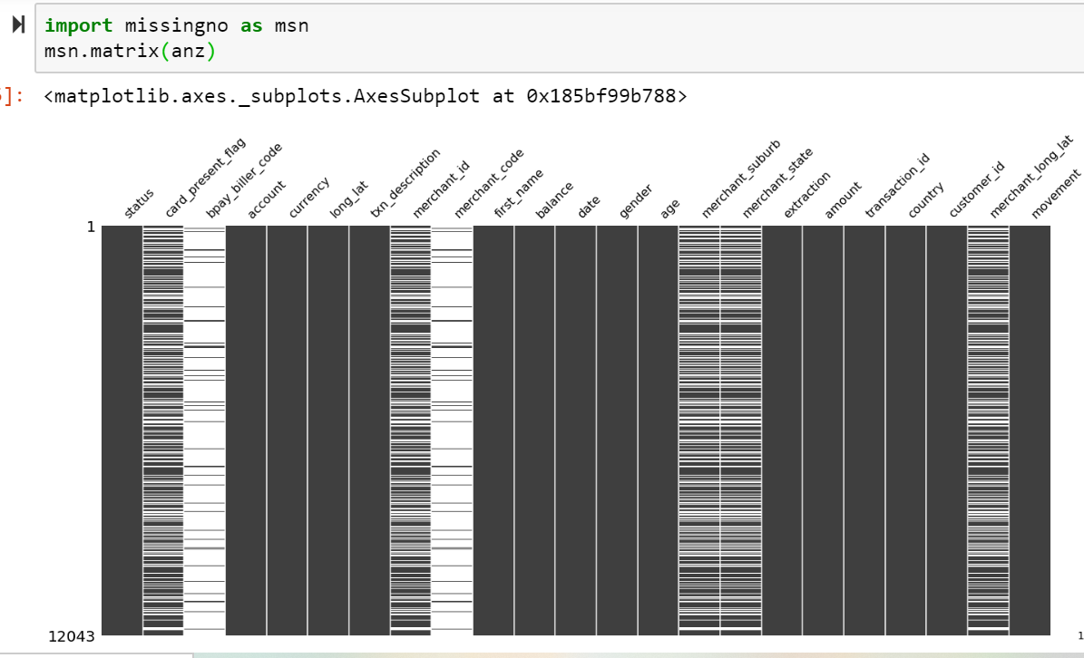
Data cleaning:
12043 columns
23 rows.
Missing values : 43948
The features bpay_billercode and merchant code has the highest number of missing values.
Features namely card_present_flag and merchant_id,
merchant_suburb,merchant_state and merchant_log_lat
has the same pattern regarding missing values.
The features country,currency are redundant columns.
removed 'country','currency','bpay_biller_code’,
'merchant_code’ features.

Slide 3
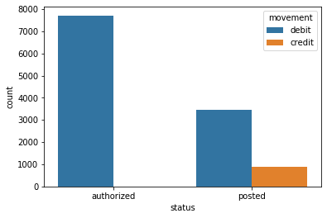
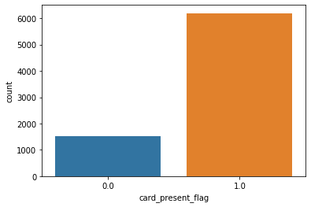
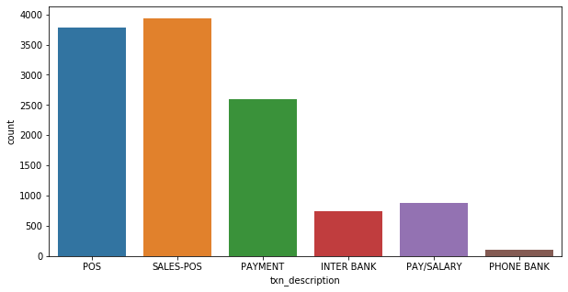
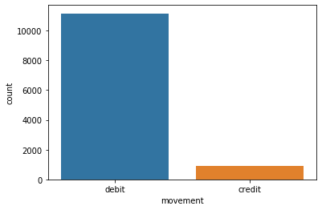
Authorised transactions are higher than posted transaction and credit card is only used in posted transactions.
In majority of the transactions card is not submitted and there fore it is flagged.
Debit card transactions are higher than credit card transactions.
Transaction of sales POS and POS are higher and internet banking and phone banking transactions are the lowest.

Slide 4
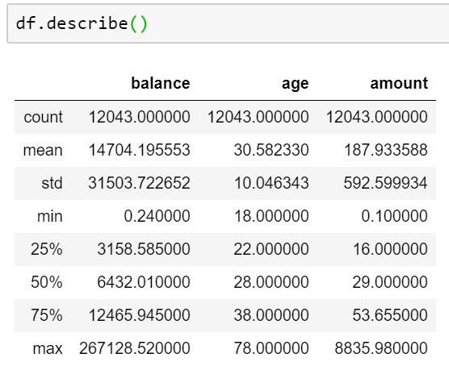
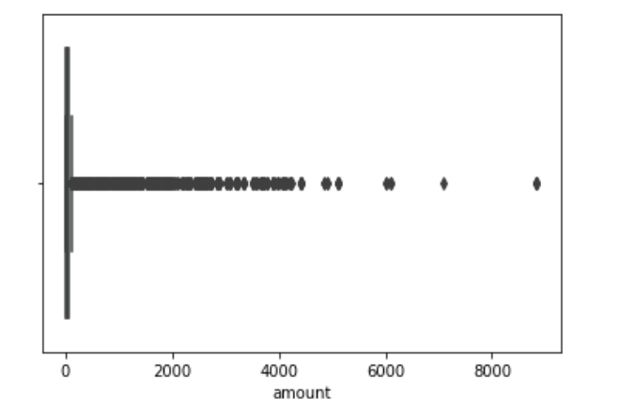
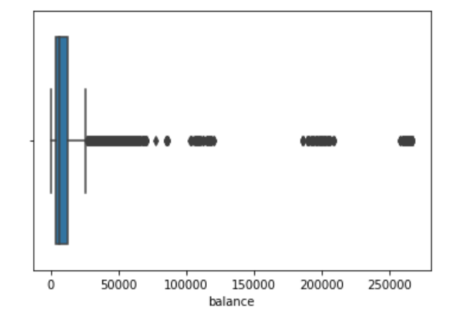
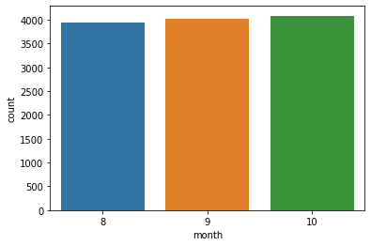
There are extreme values in both amount and balance features,but since they are important in analysis of data we cannot remove them.
The number of transactions are almost same In the consecutive months with a slight increase from august to October.

Slide 5
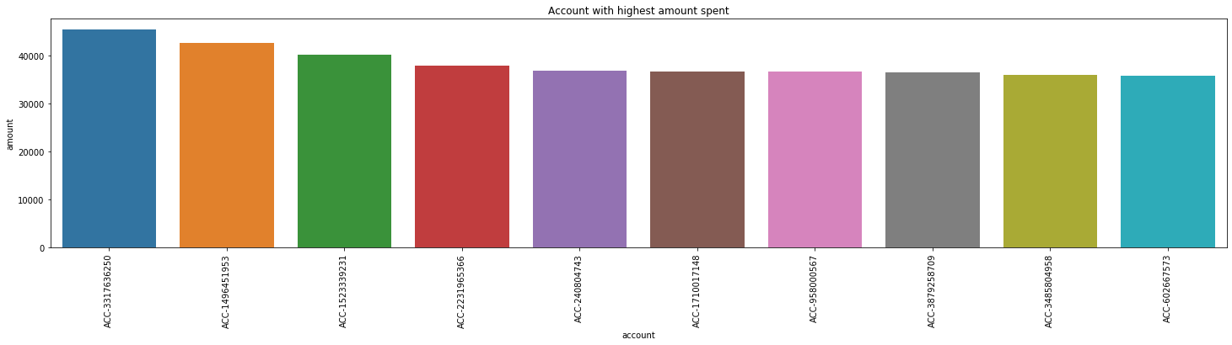
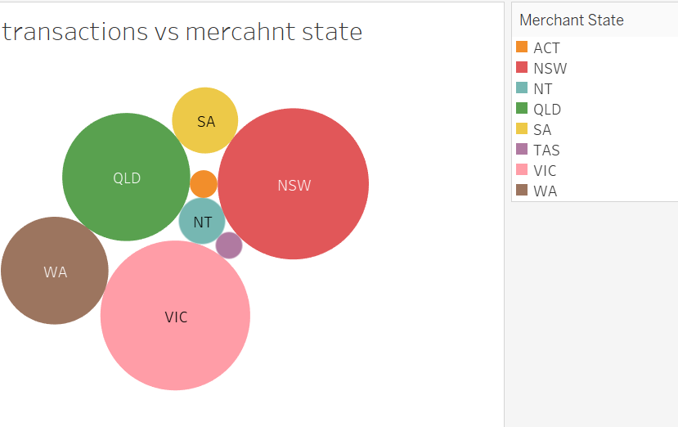
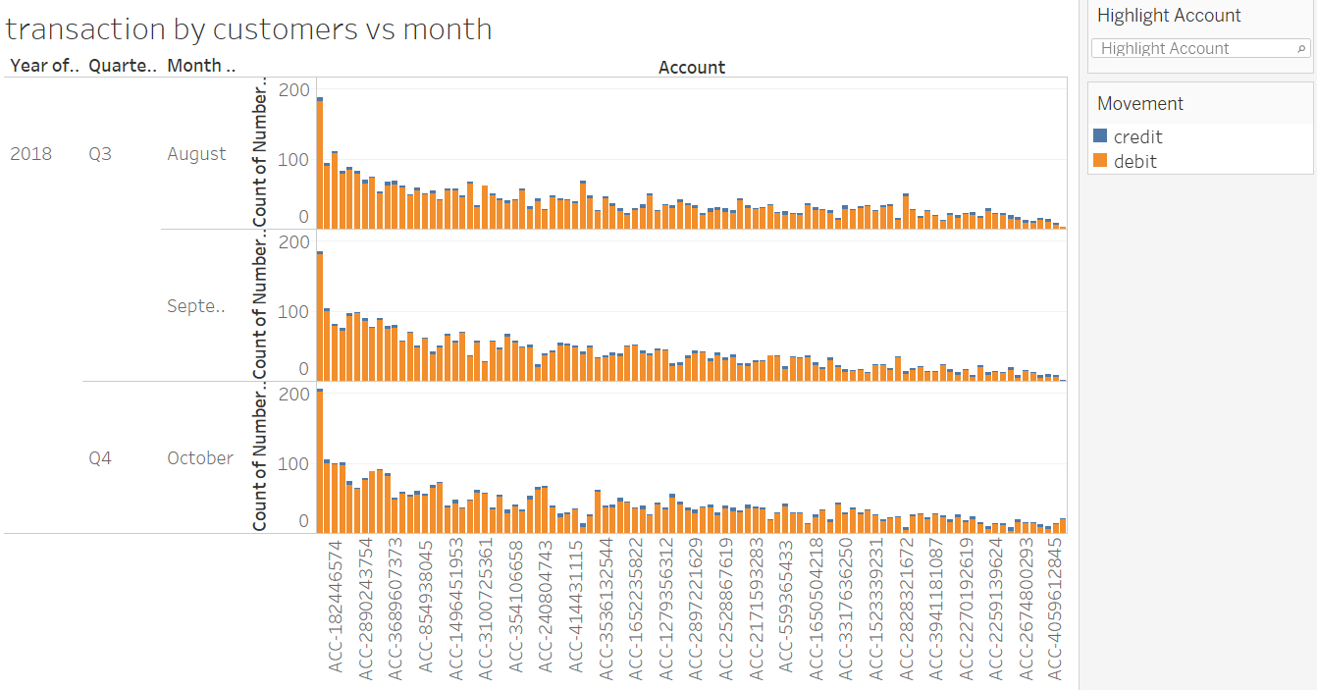
The top 10 customers with the highest amount of transactions.
NSW has the highest number of transactions followed by vic .
The number of transactions by each customers on the 3 months.

Slide 6
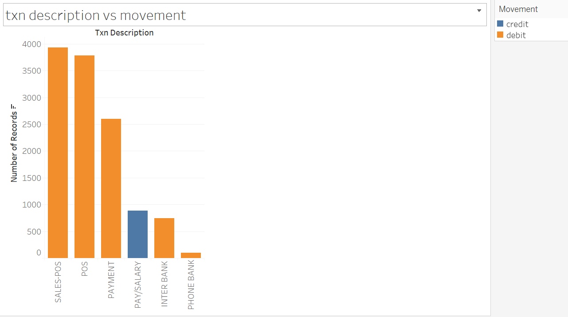
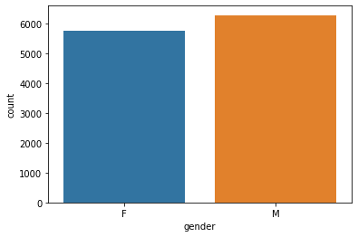
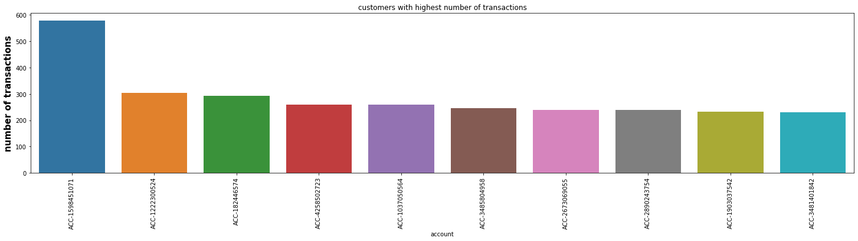
Pay/salary transactions are debited and others are credicted
Transactions by males are higher than the transactions by females.
Customers with the highest number of transactions

Slide 7
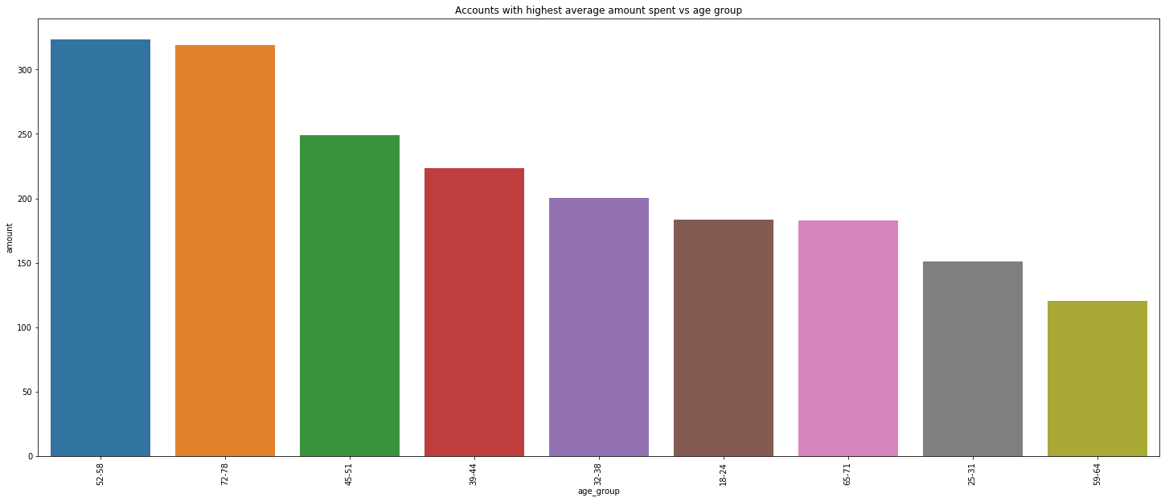
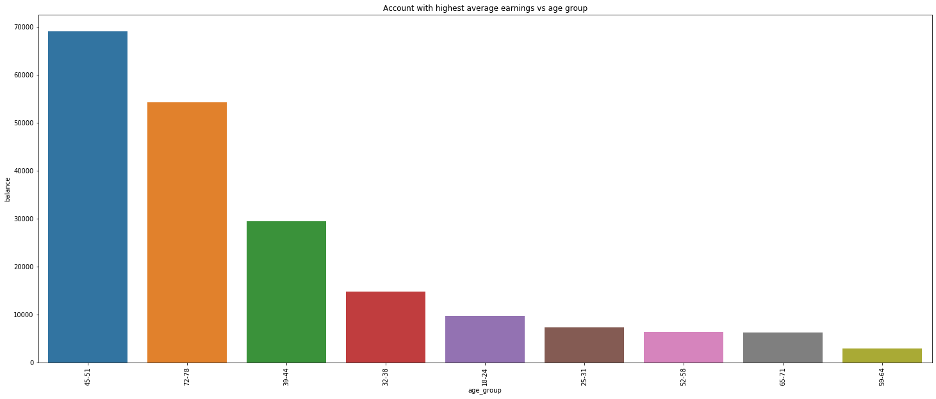
age groups with highest average transaction amount
Age groups with highest average earnings.

Slide 8
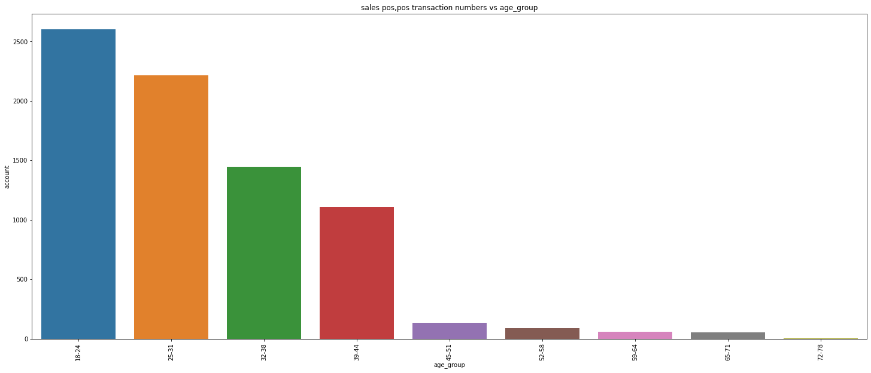
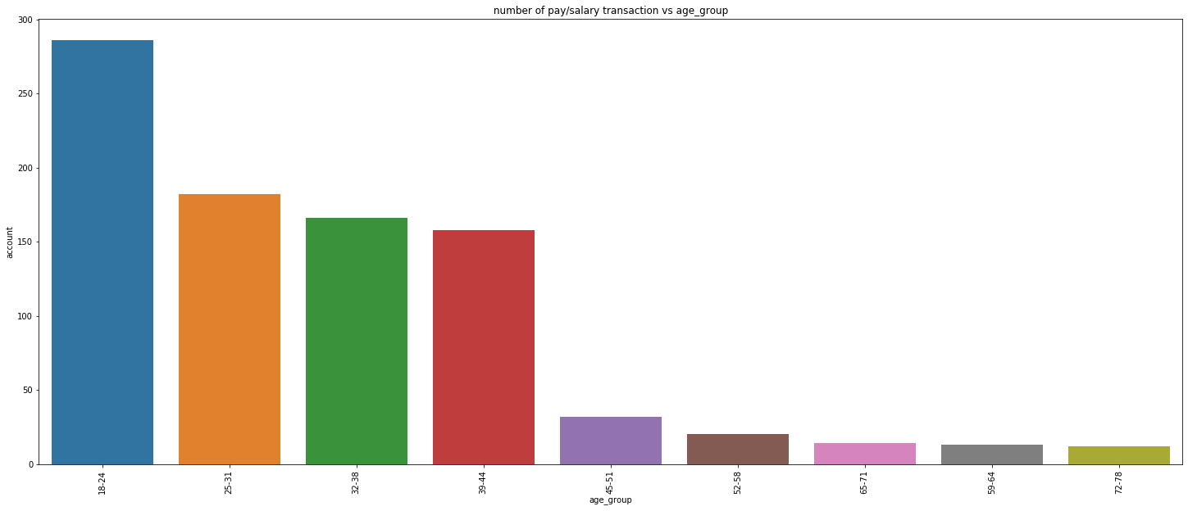
Variation in the sales pos,pos transactions in the various age groups.
Variation in pay/salary transactions in age groups

